Slide 1


React Js

Slide 2
React Components
React component is the building block of a React application.
A React component represents a small chunk of user interface in a webpage. The primary job of a React component is to render its user interface and update it whenever its internal state is changed. In addition to rendering the UI, it manages the events belongs to its user interface. To summarize, React component provides below functionalities.
Initial rendering of the user interface.
Management and handling of events.
Updating the user interface whenever the internal state is changed.

Slide 3
React component accomplish these feature using three concepts −
Properties − Enables the component to receive input.
Events − Enable the component to manage DOM events and end-user interaction.
State − Enable the component to stay stateful. Stateful component updates its UI with respect to its state

Slide 4
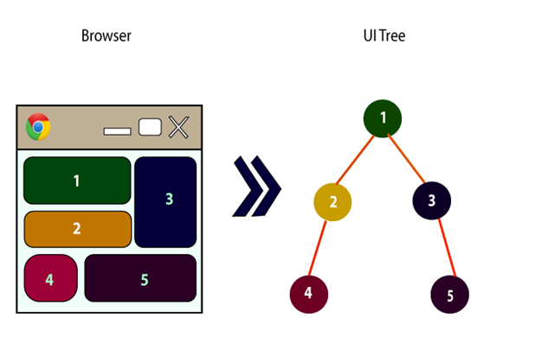
Every React component have their own structure, methods as well as APIs. They can be reusable as per your need. For better understanding, consider the entire UI as a tree. Here, the root is the starting component, and each of the other pieces becomes branches, which are further divided into sub-branches.

Slide 5
Creating a React component
React library has two component types. The types are categorized based on the way it is being created.
Function component − Uses plain JavaScript function.
ES6 class component − Uses ES6 class.
The core difference between function and class component are −
Function components are very minimal in nature. Its only requirement is to return a React element.
function Hello() {
return '<div>Hello</div>’
}

Slide 6
The same functionality can be done using ES6 class component with little extra coding.
class ExpenseEntryItem extends React.Component {
render() {
return (
<div>Hello</div>
);
}
}
Class components supports state management out of the box whereas function components does not support state management. But, React provides a hook, useState() for the function components to maintain its state.
Class component have a life cycle and access to each life cycle events through dedicated callback apis. Function component does not have life cycle. Again, React provides a hook, useEffect() for the function component to access different stages of the component.

Slide 7
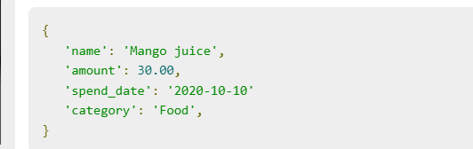
Creating a class component
Let us create a new React component (in our expense-manager app), ExpenseEntryItem to showcase an expense entry item. Expense entry item consists of name, amount, date and category. The object representation of the expense entry item is −

Slide 8
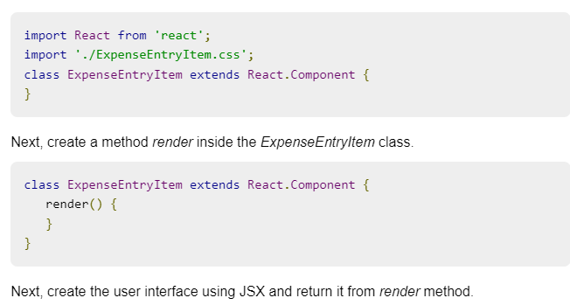
Next, create a file, ExpenseEntryItem.css under src/components folder to style our component.
Next, create a file, ExpenseEntryItem.js under src/components folder by extending React.Component.

Slide 9
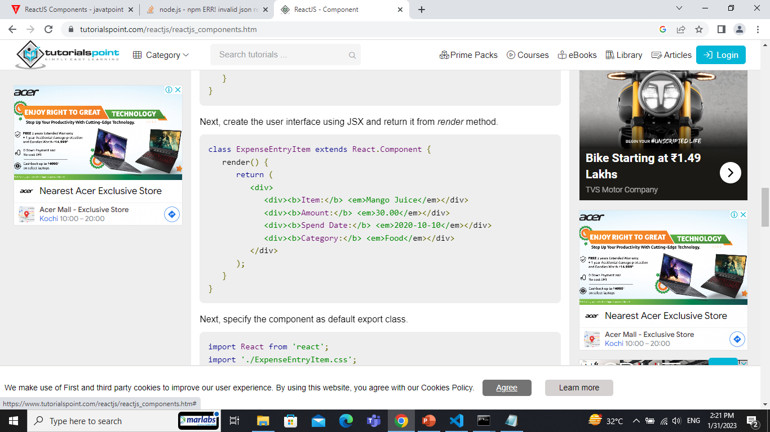

Slide 10
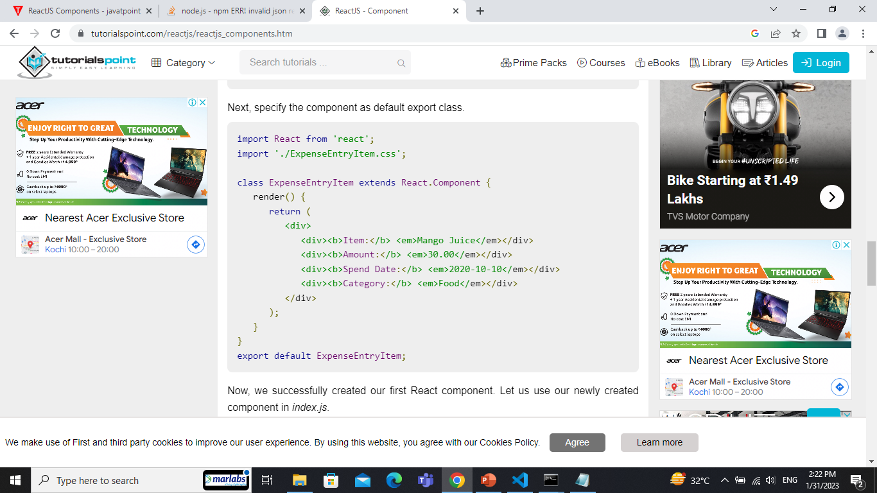

Slide 11
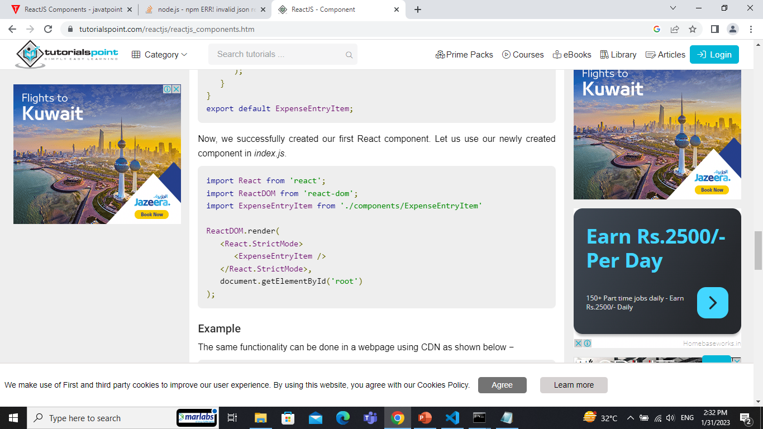
Now, we successfully created our first React component. Let us use our newly created component in index.js.

Slide 12
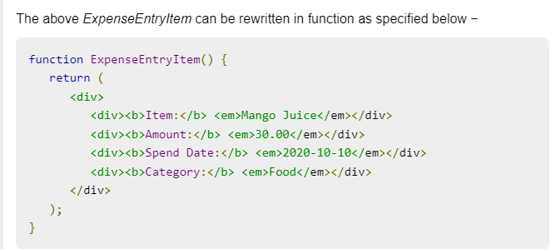
Creating a function component
React component can also be created using plain JavaScript function but with limited features. Function based React component does not support state management and other advanced features. It can be used to quickly create a simple component.

Slide 13
Thank You

